Slide 1


Titolo presentazione sottotitolo
Students: Daniele Sinigaglia & Vicente Castro
Group Name: BlowYourHat
HAEAI project: Fruit Scale Recognition
Milano, 22 January 2024
Notes:
The last two slides are used to be duplicated, don’t edit them.

Slide 2

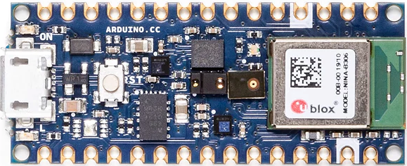
A scale empowered with AI
A scale
An LCD display with touch screen
Arduino® Nano BLE sense rev.2 board
Nordic® Semiconductor nRF52840 microcontroller
OV7675 camera module 0.3MP

Slide 3
Smart Fruit Recognition

Slide 4
Introduction
Customer Needs: (e.g. Machine learning can be used to identify fruit based on its characteristics)
Target is qualitative: classification
Dataset questions:
N° of samples
N° of variables/type of variables
Prospective: Formalize the experimental design: inclusion/exclusion of criteria that define the acquisition of dataset
Retrospective: Formalize the experimental design: inclusion/exclusion of criteria that define the selection of dataset

Slide 5
Introduction (Continue)
Project objectives (e.g. supermarket’s efficiency)
Required learning dataset (specifically input/output dataset)
Warn the customer that the learned algorithm may not work on new data acquired under different condition.

Slide 6
Business
Market and values

Slide 7
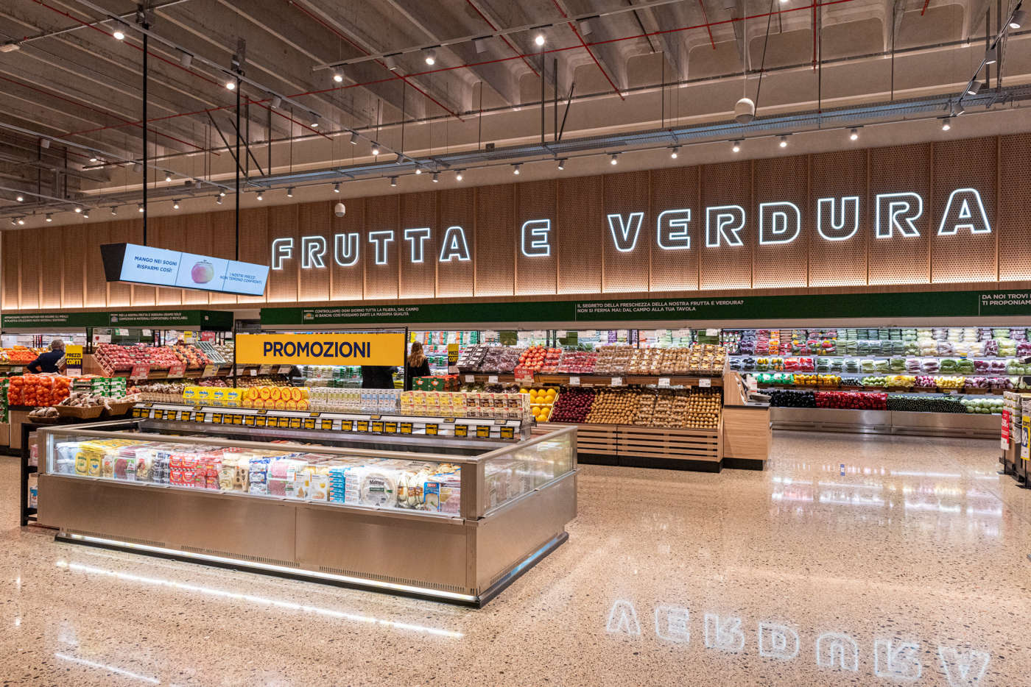
Business - Target
Supermarket
Ipermarket

Slide 8
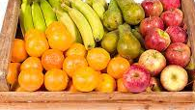
A market perspective
Already available smart scales (e.g. belgian supermarket)
All-in-one product
Training and workshop: we offer training courses and workshops on various aspects of customer satisfaction

Slide 9

Business - Values
In this context:
Customer Orientation: The customer is at the center of every decision.
Sustainability: A commitment to sustainable business practices.
Innovation: The adoption of new technologies and processes to improve operational efficiency and customer experience.

Slide 10
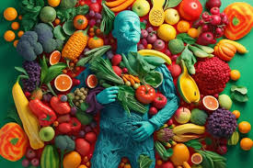
Customer Orientation
Putting customer needs at the heart of the business you increase profit.
The removed repetitive tasks leave space for imagination and inspiration.
Workers have an increased commitment to the public.

Slide 11
Sustainability
Efficient use of energy
Sustainable packaging are now fully sustainable without sticky labels
Reducing food waste with more fruit and vegetables sales

Slide 12
Innovation
Old scales cause different issues to customers and cashiers.
Added value and customer loyalty

Slide 13
Integration with the already present architecture
Complete substitution of the present scales with our new Fruit Scale Recognition

Slide 14
Technical Review

Slide 15
Ethical Review
Privacy, inclusivity and user well-being

Slide 16
Aspects
Engineering design has been regarded as a form of materializing morality.
Privacy
Inclusivity
Job displacement
Good care and user well-being

Slide 17
Privacy
Who decides?
Who takes the responsibilities?

Slide 18
Inclusivity

Slide 19
Job displacement

Slide 20
Good care and user well-being

Slide 21
Future Developments

Slide 22

Future developments
Fully integration with smart bar-code readers
Add more fruit and vegetable categories
LCD display that shows results in a smart way
Federated learning to enhance the predictions

Slide 23
Sources
1. [https://asq.org/quality-resources/customer-satisfaction].
2. Eurostat - Infographic: Daily consumption of fruit and vegetables in the EU, 2019.
3. Come l’intelligenza artificiale sta ridisegnando il lavoro - Hbr Italia.
4. I vantaggi della sostenibilità per le aziende (asvis.it).
5. Supermercati sostenibili: stop plastica ed emissioni e salvare il cibo (ilfattoalimentare.it).

Slide 24
Acknowledgements
THANK YOU
QUESTIONS?

Slide 25

Inserimento secondo logo
Fare clic per modificare lo stile del titolo
Fare clic per modificare lo stile del sottotitolo dello schema

